Slide 1

BAPE
Streetwear Industry Near Future Outlook
Start Slide
Fall 2024

Slide 2

Executive
Summary
E-commerce to rise to 50% of global retail sales by 2030
Social media presence is critical to gaining new customers
BAPE margins at risk as high tariff hikes loom amid tight 2024 US election

Slide 3
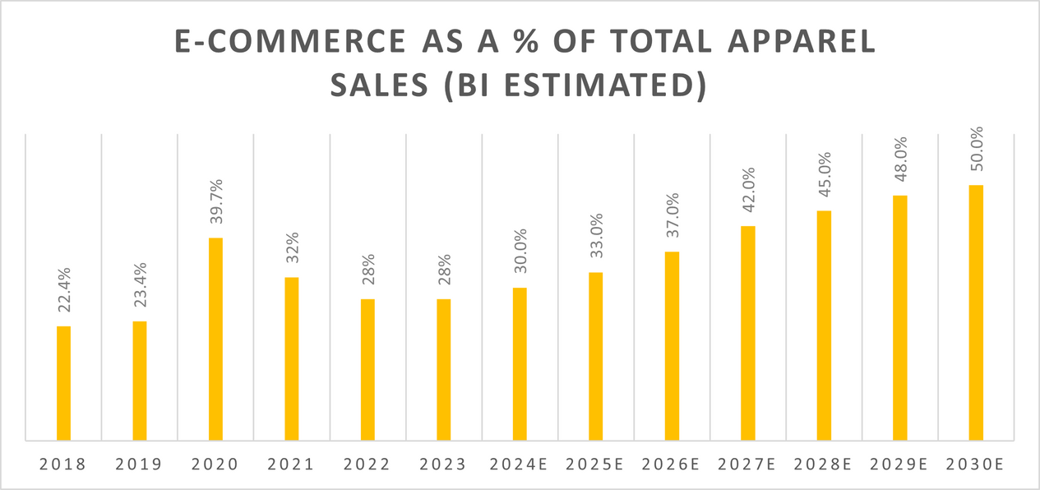
Executive
Summary
E-COMMERCE TO RISE TO 50% OF ALL GLOBAL RETAIL SALES BY 2030
  Represents strong opportunity to grow BAPE e-commerce operations and ride the wave
  Simultaneously represents a threat to BAPE’s current limited stores strategy
  With competitors like Supreme and Off-White prioritizing e-commerce, a strong online presence is crucial for BAPE to stay competitive and capture market share.
2024, E-commerce outlook: a leap to 34% of US retail, Poonam Goyal and Sydney Goodman, Accessed October 22, 2024
Bloomberg Finance LP, “BI Forecast - Retail Sales.” Excel File, Accessed October 22, 2024

Slide 4



SOCIAL MEDIA PRESENCE IS CRITICAL TO GAINING NEW CUSTOMERS
84%
145 Minutes
of people 18-29 years old use social media
average time a person spends on social media per day
  Urban Outfitters grew customer base by 19% after successful TikTok campaign in 2023
  Levi Strauss launched a global campaign across Instagram, TikTok, and YouTube inviting viewers to join in - aiding US market share in Q1 2024
Forbes Advisor. “Social Media Statistics and Facts (2023).” Forbes
2024, TikTok, Instagram, YouTube, Critical to Gain Customers, Poonam Goyal and Sydney Goodman, Accessed October 22, 2024

Slide 5
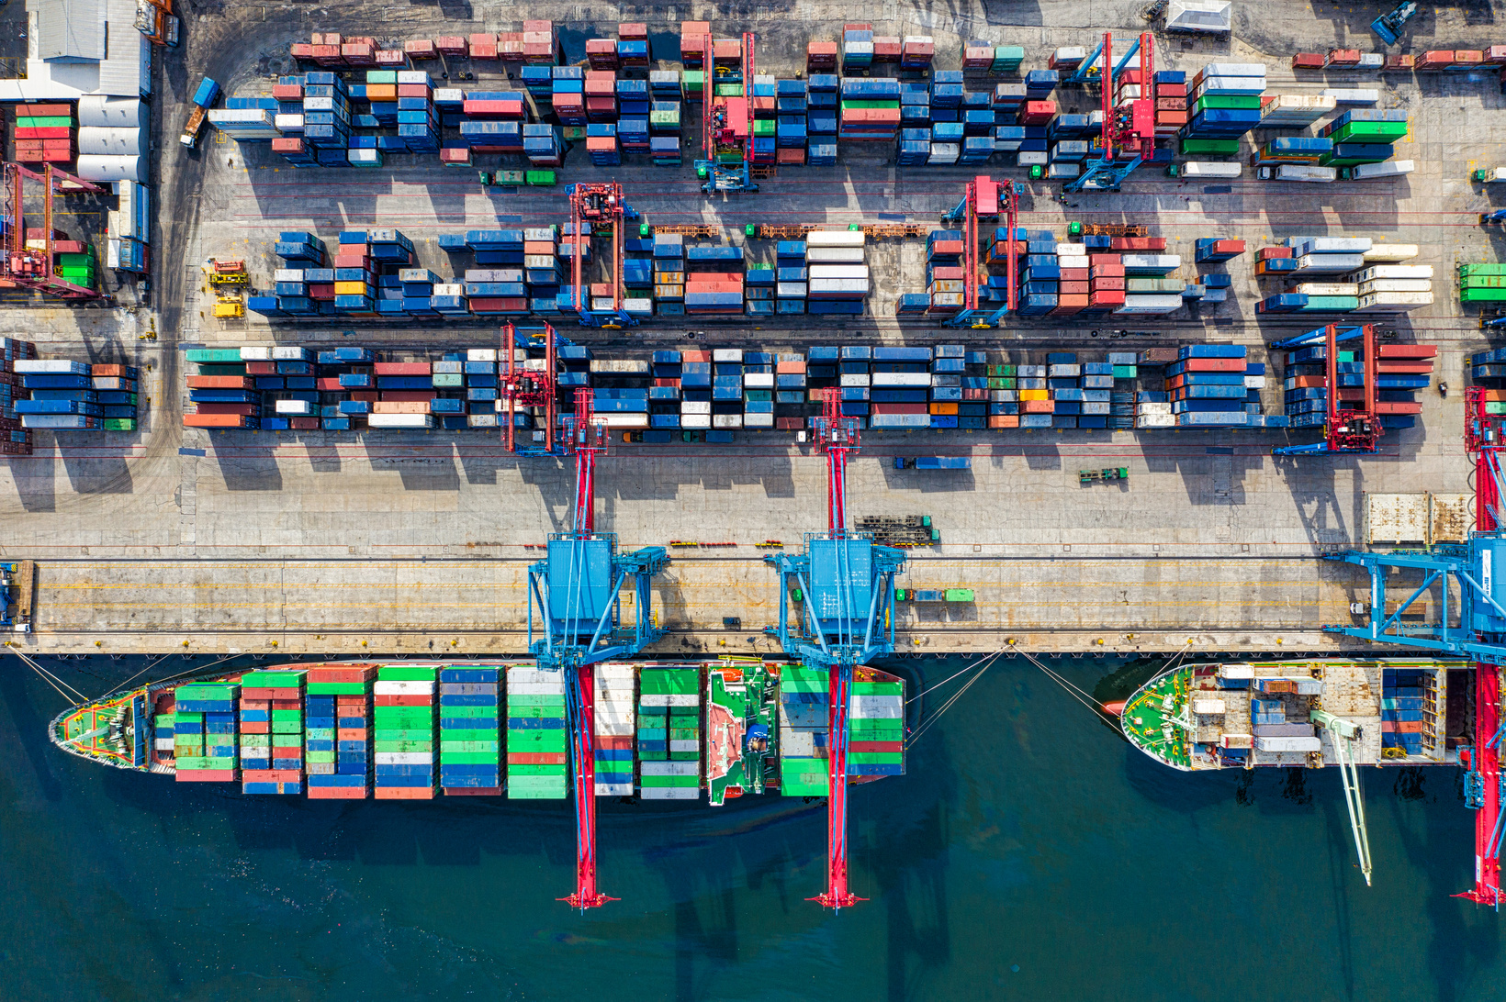
BAPE MARGINS AT RISK AS TARIFF HIKES LOOM AMID TIGHT 2024 US ELECTION
Democratic Victory
Republican Victory
  Tariffs likely to remain unchanged
  Proposed tariff changes don’t impact apparel goods and are more targeted on resources like metals
  Tariffs likely to get hiked
  Proposed tariffs include 60% on ALL goods imported from China
  BAPE’s products are manufactured in China and the parent company is based in Hong Kong
Because the US makes up 33% of Net BAPE sales margins are more exposed to potential tariff hikes
2024, US Presidential Election Impact on Tariffs, Poonam Goyal and Sydney Goodman, Accessed October 22, 2024
2024, North America apparel midyear outlook, Poonam Goyal, Accessed October 22, 2024

Slide 6
NEXT STEPS TO TAKE BY 2030
Develop E-Commerce Infrastructure
Insulate tariff impacts by outsourcing
Foster Social Media Presence
  Don’t want to miss the e-commerce “wave”
  Expanding our e-commerce operations now is critical
  Develop strategies that boost availability but don’t damage scarcity
  Plan now to move production out of China
  Leverage new e-commerce and social media strategies to access new customers outside of the US
  Advertise where people are living
  Create a community on social media that will expand brand power and customer base
  Authentically build loyal following

Slide 7
ENDNOTES
  2024, North America apparel midyear outlook, Poonam Goyal, Accessed October 22, 2024
  Forbes Advisor. “Social Media Statistics and Facts (2023).” Forbes. Last modified August 25, 2023. https://www.forbes.com/advisor/business/social-media-statistics/#source.
  2024, US Presidential Election Impact on Tariffs, Poonam Goyal and Sydney Goodman, Accessed October 22, 2024
  2024, E-commerce outlook: a leap to 34% of US retail, Poonam Goyal and Sydney Goodman, Accessed October 22, 2024
  Bloomberg Finance LP, “BI Forecast - Retail Sales.” Excel File, Accessed October 22, 2024
  2024, TikTok, Instagram, YouTube, Critical to Gain Customers, Poonam Goyal and Sydney Goodman, Accessed October 22, 2024

